Slide 1
Simulation Modeling Analysis
Selecting Input Probability Distributions
Md. Fazlul Karim Patwary
Professor
Institute of Information Technology Jahangirnagar University

Slide 2
Probability Distributions and Simulation
Almost all real-world systems contain one or more sources of randomness
Manufacturing: processing times, machine operating times before a downtime
Computer: interarrival times of jobs, job types, processing requirements of jobs
Communication: interarrival times of messages, message lengths
Random variables can be described by their probability distribution functions
To carry out a simulation using random inputs such as interarrival times, we have to specify their probability distributions

Slide 3
Probability Distributions and Simulation
Example
Consider a single-server queueing system with exponential interarrival time with a mean of 1 minute
Suppose the following simulation has been performed
Use five different probability distributions to model the service time
100 independent simulation runs for each of the distribution
Each simulation run was continued until 10,000 delays in queue were collected

Slide 4
Probability Distributions and Simulation
Service-time distribution | Average delay in queue | Average number in queue | Output errors (Compare to Weibull)
Exponential | 4.356 | 4.363 | 62%
Gamma | 2.849 | 2.854 | 6%
Weibull | 2.687 | 2.692 | 0%
Lognormal | 4.816 | 4.825 | 79%
Normal | 3.308 | 3.309 | 23%

Slide 5
Probability Distributions and Simulation
Example : Discussion
In this case, Weibull distribution actually provides the best model for the service-time data for the actual system
– The average delay for the real system should be close to
2.69 minutes
– Large variations recorded for other distribution (e.g. 23% and 79% differences for normal and lognormal distributions, respectively)
Therefore the choice of probability distributions can evidently have a large impact on the simulation output!

Slide 6
Probability Distributions and Simulation
After collecting the data (through observations or measurements) on an random variable of interest, we can use them to specify a distribution using one of the following approaches
Trace-driven
Empirical distribution
Theoretical distribution
Trace-driven
The data values themselves are used directly in the simulation
E.g. You have recorded the points of time when customers arrived, and feed these values into the simulation directly as the arrival times
More preferred

Slide 7
Selecting Probability Distribution Functions
Empirical distribution approach
There can be times that we simply cannot find a theoretical distribution that fits the data adequately
The observed data themselves are used to specify directly a distribution (the empirical distribution)
Define an empirical distribution function based on the observed data values
Theoretical distribution approach
Fit a theoretical distribution form (e.g., exponential, Poisson,…) to the data and to perform hypothesis tests to determine the goodness of fit

Slide 8
Empirical Distributions (cont)
Suppose we have a collection of n data on a continuous random variable
– X₁, X₂, …, X_{n}
Note: these n data are the samples of the continuous random variable
Sorted into increasing order as X₍₁₎, X₍₂₎, …, X_{(n)}
E.g. X₁ = 4 seconds, X₂ = 2.9 seconds, X₃ = 2.5 seconds, X₄ = 3.3 seconds, X₅ = 5.5 seconds, X₆ = 1.2 seconds
– Then X₍₁₎ = 1.2, X₍₂₎ = 2.5, X₍₃₎ = 2.9, X₍₄₎ = 3.3, X₍₅₎ = 4, X₍₆₎
= 5.5
Let X_{(i)} denote the ith smallest value, then the empirical distribution function F is given by

Slide 9
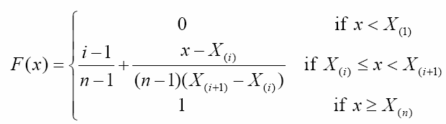
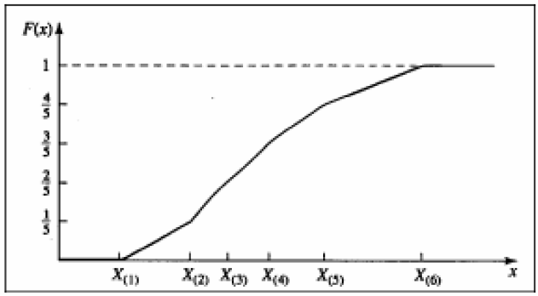
Empirical Distributions (Cont.)
Let X_{(i)} denote the ith smallest value, then the empirical distribution function F is given by

Slide 10
Selecting Probability Distribution Functions
Given a set of observed data, how to select a theoretical distribution?
Suggestion: first make a good guess of the distribution
Discrete or continuous?
How does the distribution look like?
Then find the parameters of the distribution that best fits the data (parameter estimation)
Then see how good is the fitting between the distribution and the data (goodness-of-fit test)

Slide 11
Selecting Probability Distribution Functions
For a given family of distributions, there are three basic types of parameters to describe the distribution function
Location parameter γ: specifies the x-axis location point of a distribution’s range of values
A change in location parameters cause the distribution function to shift left or right
E.g., μ for normal distribution, a and b for uniform distribution
Scale parameter β: determines the scale of the range of the distribution
A change in scale parameter compresses or expands the distribution without altering its basic form or shape
E.g., σ for normal distribution
Shape parameter α: determines the basic form or shape of a distribution
Some distributions (e.g. exponential and normal) do not have a shape parameter, while others (e.g. beta) may have two

Slide 12
Useful Probability Distributions for Simulation
We review the following theoretical probability distributions useful to simulation
Discrete:
Bernoulli, Binomial, Geometric, Negative Binomial, Poisson, Discrete Uniform
Continuous:
Uniform, Exponential, m-Erlang, Gamma, Weibull
Theoretical probability distributions can be described by a function
p(x), probability mass distribution function for discrete r.v.
f(x), probability density function for continuous r.v.

Slide 13
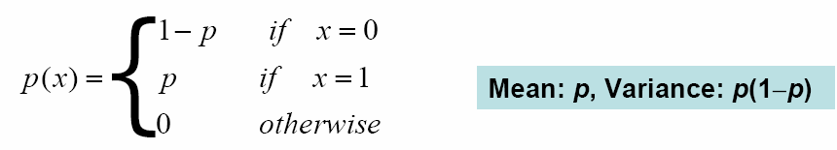
Bernoulli Distribution: Bernoulli (p)
Used to model the distribution with two possible outcomes
E.g. coin flipping
A customer will click a login button or not
A server is up or down
Parameter: p

Slide 14
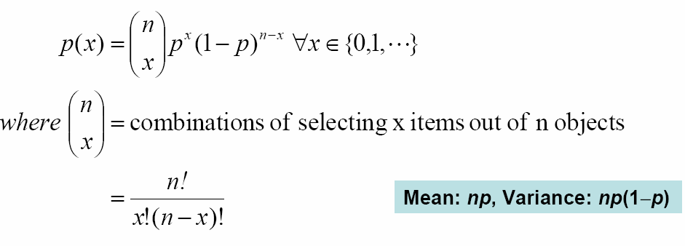
Binomial Distribution: bin(n,p)
Used to model the number of x successes in n Bernoulli trials with probability p of success on each trial
e.g. number of defective items in a batch of size n
no. of packets that reach the destination without loss
Constant probability for each observation
n trials, where x is the number of

Slide 15
Binomial Distribution: bin(n,p)
If Y₁, Y₂, …, Y_{n} are independent Bernoulli(p) random variables, then Y₁+Y₂+…+Y_{n} ~ bin(n, p)
If X₁, X₂, …, X_{n} are independent random variables and
X_{i} ~ bin(t_{i} , p) random variables, then
X₁+X₂+…+X_{n} ~ bin(t₁+t₂+…+t_{n},p)

Slide 16
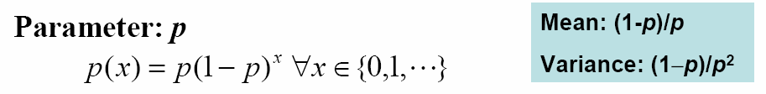
Geometric Distribution: geom(p)
To model the number of failures before the first success in a sequence of independent Bernoulli trials with probability p of success on each trial
E.g. Number of items inspected before encountering the first defective item
E.g. life time (discrete, e.g. days) of disk access before crash

Slide 17
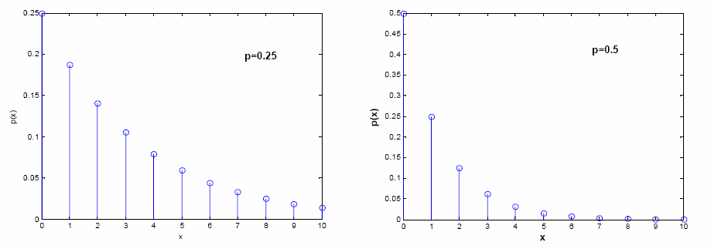
Geometric Distribution: geom(p)
Probability mass function of geom(p)
Probability of success = p for all independent trials
The probability for having x fail trials before the first success ( p(x) ) is given below

Slide 18
Geometric Distribution: geom(p)
The geometric distribution is the only discrete distribution with the memoryless property (remembering the number of failures that have been encountered does not help in predicting how many failures that will be encountered till the first success)
– Because whether you will be successful or not is independent from the number of trials you have made so far
Geometric distribution is the discrete analog of the exponential distribution
If Y₁, Y₂, …, Y_{n} are independent Bernoulli(p) random variables and X=min{i: ƩY_{i}=1} – 1, then X ~ geom(p)

Slide 19
Negative Binomial Distribution: negbin(m,p)
To model the number of failures before the m-th success in a sequence of independent Bernoulli trials with probability p of success on each trial
– E.g. number of retransmissions of a message consisting of m packets
Parameter: m, p m-th success

Slide 20
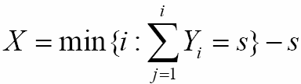
Negative Binomial Distribution: negbin(m,p)
Geometric distribution is a special case of negative binomial (m=1)
If Y₁, Y₂,…, Y_{m} are independent geom(p) random variables then Y₁+Y₂+…+Y_{m}~ negbin(m, p)
If Y₁, Y₂,…, are independent Bernoulli(p) random variables and
then X~negbin(s, p)
If X₁, X₂,…, X_{m} are independent random variables and
X_{i}~ negbin(m_{i}, p), then Y₁+Y₂+…+Y_{n}~ negbin(m₁+m₂+…+m_{n}, p)

Slide 21
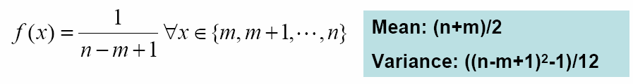
Discrete Uniform Distribution: UD(m,n)
A finite number of values, each with the same probability
The I/O device number selected for next I/O
The source and destination number of the next packet on a network
m: lower limit. m must be an integer
n: upper limit. n must be an integer greater than m
Parameter: m (location), n(scale)

Slide 22
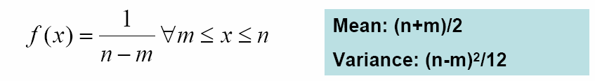
Continuous Uniform Distribution: U(m,n)
Probability of the random variable having the value between m and n is uniform
Can be used as a “first” model for a quantity that is felt to be randomly varying between m and n but about which little else is known
Location parameter: m, scale parameter n

Slide 23
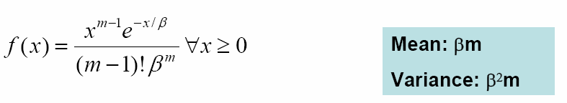
Erlang Distribution: m-Erlang (β)
To model the overall service time in a queueing network of m
successive servers
each server is independent and has the same exponentially distributed service times
Assume no intermediate queues (delay resources)
If Y₁, Y₂, …, Y_{m} are independent exp(β) random variables and
Y₁+Y₂+…+Y_{m}~ m-Erlang(β)
m-Erlang(β) is also known as gamma(m, β)
Shape parameter m, scale parameter β
– f(x) for m-Erlang can be derived from that of the exponential distribution. We don’t go through the detail here

Slide 24
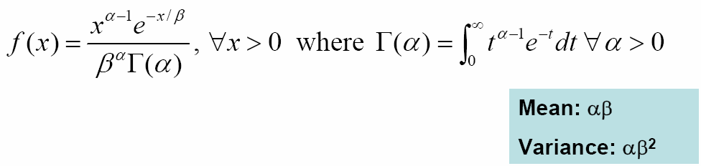
Gamma Distribution: gamma(α,β)
Models the time to complete some task with α parts each takes β time to complete
m-Erlang(β) = gamma(m, β)
exp(β) = gamma(1, β)
gamma(α,β) is a generalization of m-Erlang(β) becauseαcan be a non-integer
Shape parameter: α, Scale parameter: β
Γ(α) is a generalization of n!
Γ(α+1) = αΓ(α) for α>0, Γ(k+1) = k! if k is a nonnegative integer

Slide 25
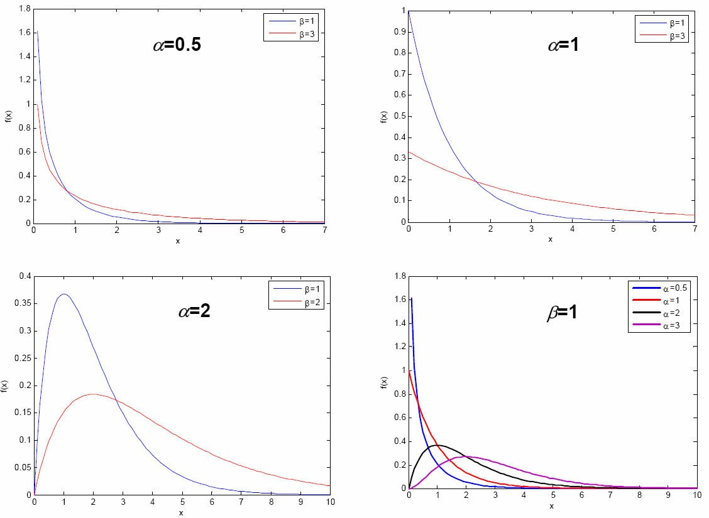
Gamma Distribution: gamma(α,β)

Slide 26

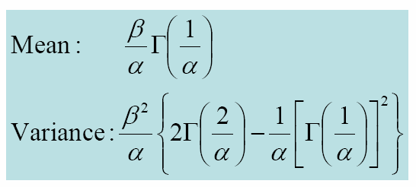
Weibull Distribution: Weibull(α, β)
Used to model time to complete a task
Instead of having a constant mean service time (such as exponential), such value is a variable in Weibull (depending on α)
If the service time decreases over time, then α < 1
If the service time is constant over time, then α = 1 (= exponential)
If the service time increases over time, then α > 1

Slide 27
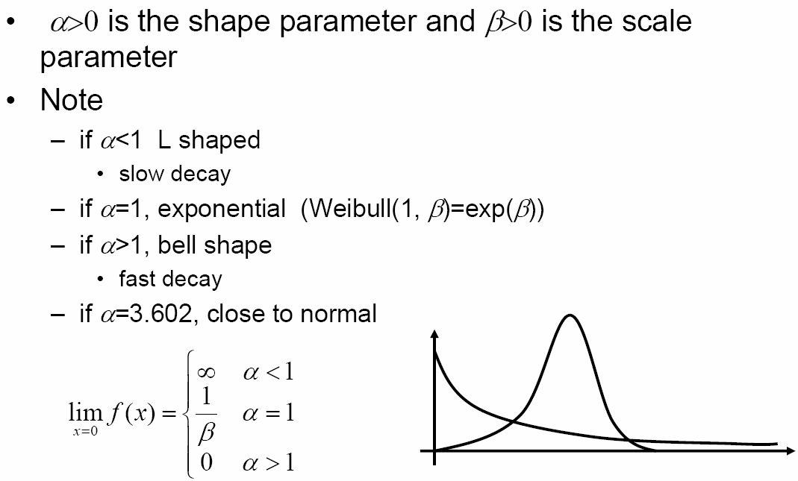
Weibull Distribution: Weibull(α, β)

